Slide 1

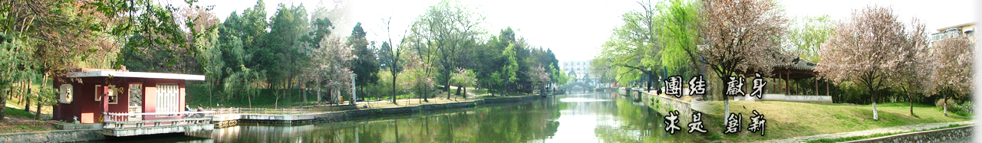
4 Common Representational Format
EOE Postgraduate Courses
Multi-sensor Data Fusion
wangjingqi@njust.edu.cn

Slide 2
Contents
4.1 Introduction
4.2 Spatial-Temporal Transformation
4.3 Geographical Information System
4.4 Common Representational Format
4.5 Subspace Methods
4.6 Multiple Training Sets

Slide 3

4.1 Introduction
Common representational format (通用表现格式）
A basic requirement for all multi-sensor data fusion systems.
the sensor observations are compatible and sensor fusion may be performed.
Three functions of a common representational format
The notation for a sensor observation in (2.1).
Spatial Alignment.
Transformation of local spatial positions x to a common coordinate system.
involving geo-referencing the location and field-of-view of each sensor.
Temporal Alignment.
Transformation of the local times t to a common time axis.
often performed using a dynamic time warping algorithm.
Sensor Value Normalization.
The sensor values y and their uncertainties Δy are normalized to a common scale.
This process is often performed using robust statistics.
Notes:
Corresponding to the three types of information - spatial, temporal and value
– the process of converting the sensor observations into a common representational format involves the following three functions.

Slide 4
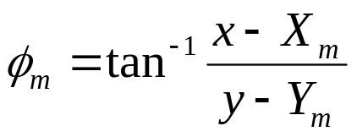
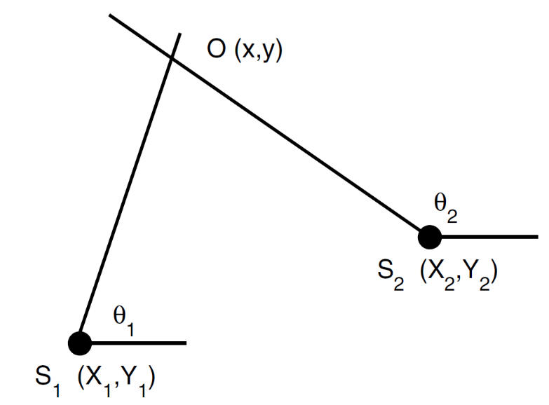

Example 4.2. Bayesian Triangulation of Direction-Bearing Measurements
The position of the object O is estimated from M direction-bearing observations made from known locations.
(x, y) denotes the Cartesian coordinates of the object; ϕ_{m} denote its true bearing from a sensor S_{m} located at (X_{m}, Y_{m}), m∈ {1, 2, …, M}, then
The measured bearings
where the w_{m} are independent and identically distributed (iid) according to a zero-mean Gaussian distribution, w_{m} ∼ N(0, σ²_{m}).
Notes:
In the following example we describe an application in which we fuse K direction-only coordinate systems into a single Cartesian coordinate system.
We reconsider Ex. 1.5 from a Bayesian point-of-view.

Slide 5
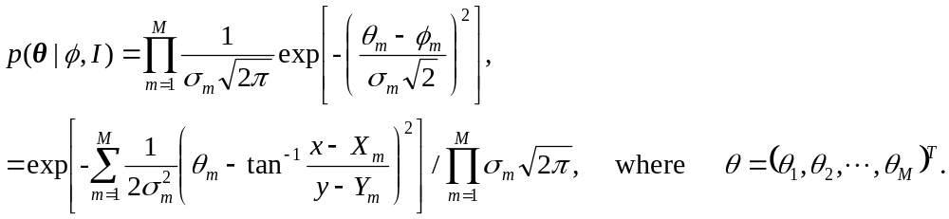
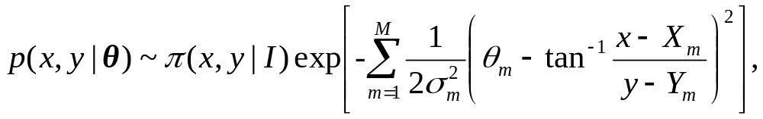
Given the bearings φ = (φ₁, φ₂, . . . , φ_{M})^{T}, the a likelihood probability density p(θ|φ, I) is
Inverting this equation using Bayes’ theorem, we get
where π(x, y|I) is an a priori probability density postulated for each (x, y) given the background information I.
The estimated location of the object O is given by the mean values:
□
Notes:
We reconsider Ex. 1.5 from a Bayesian point-of-view.
连乘： continued multiplication or continued product
分母：denominator
分子：numerator

Slide 6



4.2 Spatial-Temporal Transformation
（时空变换）
Transformation T maps the position x and time t of a sensor observation O to a position x’ , and a time t’, in a common representational format:
(4.2)
General form of T :
(4.3)
Both the spatial transformation T_{x}(x,t) and the temporal transformation T_{t}(x,t) are functions of x and t.
“Decoupled” spatial-temporal transformation （解耦的时空变换）:
(4.4)
convenient to use as a first-order approximation.
It is true when the system under observation is not changing in time.

Slide 7
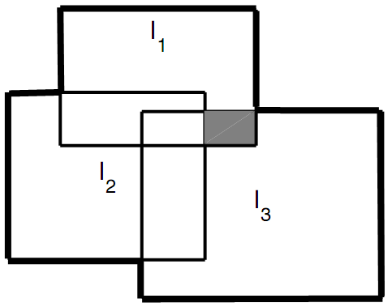

Example 4.3. A Distributed Surveillance System.
A number of video-based television cameras located in multiple locations.
A sequence of “spot” images I_{m}, m ∈{1, 2,…, M},
a common coordinate system ⎯ building a “mosaic” image I∗ from I_{m} .
a geometric transformation T_{m} ⎯ maps the local “camera-centered” coordinate system of I_{m}, to the common “object-centered” coordinate system of I∗ .
Fig. 4.1. the surveillance of a wide-area site with a sequence of “spot” images I_{m}.
In the overlap regions, the mosaic image is calculated by averaging the corresponding intensity values.
□
Notes:
The following example illustrates the construction of a common representational format for an environment which is essentially static and in which the sensors are all of the same type.
In this case the temporal alignment and value normalization functions are not required and the construction of the common representational format reduces to the construction of a common spatial coordinate system.
Consider a sequence of M narrow field-of-view “spot” images Im,m ∈ {1, 2, . . .,M}, taken of a wide surveillance area.
We establish a common coordinate system by building a “mosaic” image I∗ from the sequence of images Im (Fig. 4.1).
For each image Im, we find a geometric transformation Tm which maps the local “camera-centered” coordinate systemof Im to the common “object-centered” coordinate system of I∗.
The mosaic image I∗ is then defined as the union of the transformed images Tm(Im):
In the regions where the spot images overlap we may define the mosaic image as the average of the corresponding intensity values.

Slide 8
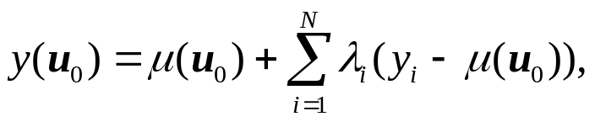
4.3 Geographical Information System
GIS combines multiple images of the earth obtained from many different sensors and maps into a common coordinate system.
Sensor measurements y(u_{i}), i ∈{1, 2,...,N}, made at specifed spatial locations u_{i}, into a continuous map.
Kriging estimators （克立格估值器）
A given point u₀, y_{i} = y(u_{i}) ⎯ the outcome of a random field y(u), located in the neighborhood of u₀. The estimated sensor value at u₀ is
where μ(u₀) is the mean value at u₀ and the weights λ_{i} are chosen to give the best unbiased solution.
Mathematically, μ(u₀) and λ_{i} are solutions of a system of linear equations known as the Kriging equations.
Notes:
In a Geographic Information System (GIS)， we combine multiple images of the earth obtained from many different sensors and maps, including demographic and infrastructure maps, into a common coordinate system.
In building a GIS we often need to convert a set of sensor measurements y(ui), i ∈ {1, 2, . . .,N}, made at specified spatial locations ui, into a continuous map.
One way of doing this is known as Kriging， where the term Kriging refers to a family of best (in the least squares sense) linear unbiased estimators (BLUE).
We interpret the yi = y(ui) as the outcome of a random field y(u).

Slide 9

Table 4.3. Kriging Estimators
Estimator | Description
Simple | Assumes a known mean value μ(u₀) =u₀ in the local neighborhood of u₀.
Ordinary | Assumes a constant but unknown mean value μ(u₀) =u₀ in the local neighborhood of u₀.
Universal | Assumes μ(u) varies smoothly in neighborhood of u₀. μ(u₀) is modeled as a linear combination of known basis functions f_{l}(u): where the parameters β_{l} are found by solving the appropriate Kriging equations.
(to be continued)
Notes:
a standardized anatomically-based coordinate system or brain atlas

Slide 10
Table 4.3. Kriging Estimators
(continued)
Estimator | Description
Indicator | Uses a threshold to create binary data. The ordinary Kriging procedure is then applied to the binary data. The covariance matrix used in the Kriging eqs. is calculated on the binary data.
Disjunctive | Uses multiple thresholds to create multiple binary input data. Cokriging procedure is then applied to the multiple binary data.
Co-Kriging | Combines the primary input measurements y(u_{i})with K auxiliary variables z₁(u), z₂(u), ..., z_{K}(u). Often used when the auxiliary variables are known at a relatively few places u_{j}.
Kriging with External Drift | Similar to Co-Kriging except the auxiliary variables are known at all u including the required location u0.
Notes:
a standardized anatomically-based coordinate system or brain atlas

Slide 11
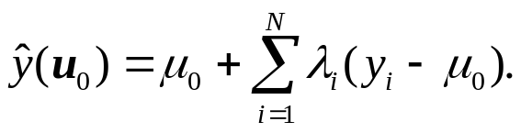
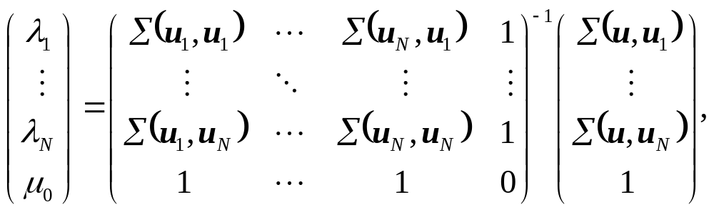
Example 4.4. Equations for Ordinary Kriging.
Mean μ(u₀) is equal to an unknown constant μ₀ in the local region of u₀.
The estimated sensor value at u₀ is
The unknown mean μ₀ and the weights λ_{i} are given by
where Σ(u_{i},u_{j} ) is the spatial covariance,
μ(u_{i}) is the mean sensor value in the neighbourhood of u_{i}.
Notes:
We model the data fusion block as a distributed network of autonomous fusion cells or nodes. Each node receives one, or more, input sensor observations.

Slide 12
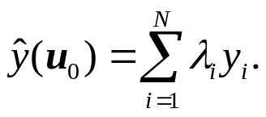
In ordinary Kriging, the weights λ_{i} sum to 1
□
Notes:
We model the data fusion block as a distributed network of autonomous fusion cells or nodes. Each node receives one, or more, input sensor observations.

Slide 13
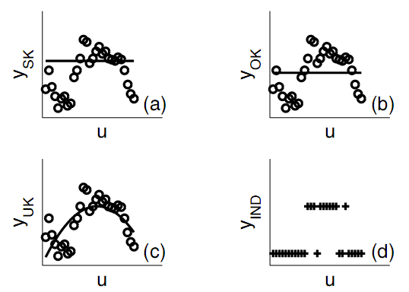
Example 4.5. A Comparison of Simple, Ordinary, Universal and Indicator Kriging
Fig. 4.2. Kriging solutions
(a) simple Kriging solution ⎯ a horizontal straight-line of given height μ₀.
(b) ordinary Kriging solution ⎯ a horizontal straight-line whose height μ₀ is optimally calculated by the algorithm.
(c) universal Kriging solution ⎯ smoothly varying curve μ(u).
(d) indicator Kriging solution ⎯ a discontinuous curve. It has a value of 0 for all points which fall below a given threshold t. All other points receive a value of 1.
□
Notes:
The simple, ordinary, universal and indicator Kriging solutions for a set of input measurements yi plotted as a function of their distance ui measured along a given straight-line.

Slide 14

4.3.1 Spatial Covariance Function
Apart from assuming a given model for the spatial mean μ(u), the only information required by the Kriging equations is the spatial covariance function Σ(u_{i},u_{j} ) .
Spatial covariance, Σ(u_{i}, u_{j}) ⎯ learning from the input measurements y_{i} subject to any a priori .
Constraints of Σ(u_{i}, u_{j}) :
positive definite → requires Σ_{i}Σ_{j}a_{i}a_{j}Σ(u_{i}, u_{j}) ≥ 0 for all u_{i}, u_{j} and real numbers a_{i}, a_{j} .
Second-order stationary → requires μ(u) to be the same for all u and Σ(u_{i}, u_{j}) to depend only on the difference h = (u_{i}−u_{j}) .
Calculation of the Covariance Matrix
Fitting the experimentally measured covariance function, , to a parametric curve Σ(h|θ), which is known to be positive definite and second-order stationary.

Slide 15
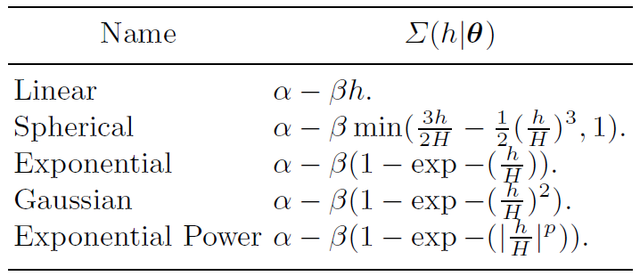
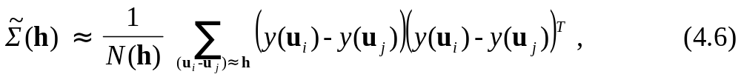
Table 4.4. Positive Definite Second-Order Stationary Univariate Covariance Functions
Let N(h) be the number of pairs of measurements (y(u_{i}), y(u_{j})) whose separation (u_{i} −u_{j}) is close to h.
Then an experimentally measured estimate of Σ(h) is

Slide 16
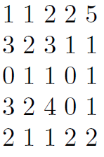
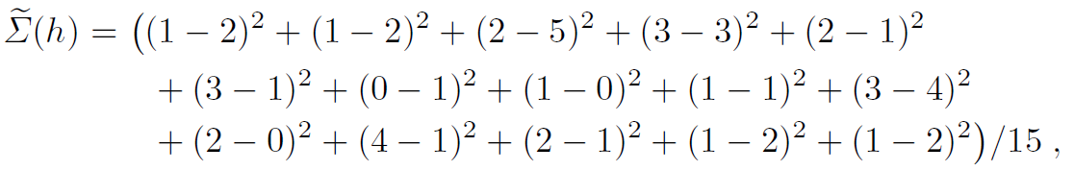
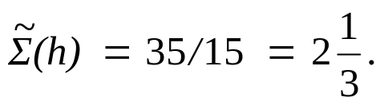
Example 4.6. Calculation of the Covariance Matrix.
Given the 5×5 digital image
The covariance matrix Σ(h) for h = 2 in the E-W direction,
or,
□

Slide 17
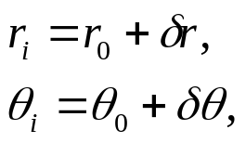
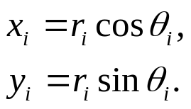
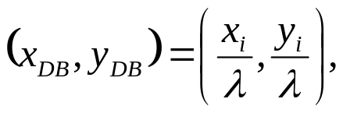

4.4 Common Representational Format
（通用表现格式）
Common representational format & Sensor measurement uncertainty.
- govern what type of fusion algorithm is used.
Example 4.7. Debiased Cartesian Coordinates
Object O in two-dimensions ⎯ a range/bearing sensor measurements (r_{i}, θ_{i}).
(r₀, θ₀) ⎯ true range/bearing of the object O,
δ_{r} ∼ N(0, σ²_{r}) δ_{θ} ∼ N(0, σ²_{θ} )
iid random measurement errors
Using Cartesian coordinate system
E(x_{i}) ≠ x₀ E(y_{i}) ≠ y₀
not unbiased estimates!
“Debiased” Cartesian coordinates (x_{DB}, y_{DB}),
where
□
Notes:
The common representational format and, in particular, the method used to represent the sensor measurement uncertainty, will govern what type of fusion algorithm is used.
For range/bearing measurements, the bias is multiplicative and the corrected coordinates are found by dividing through by a correction factor λ:

Slide 18
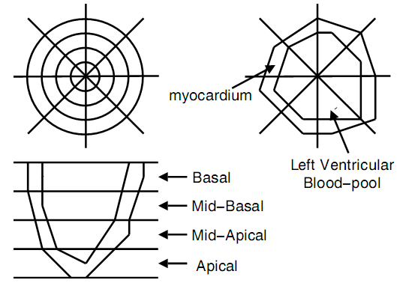
Example 4.8. Myocardial Imaging （心肌成像）
Polar maps ⎯a standard way of displaying myocardial functions; constructed by combining images from multiple planes so that information about the entire myocardium can be displayed in a single image.
Polar maps can be compared to a three-dimensional cone-shaped heart activity image projected onto a single plane.
Each image plane forms a ring in the polar map.
contains 32 sectors :
The left ventricle divided into 4 slices
Each slice divided into 8 sectors
□
Fig. 4.3. A polar image of a left ventricle.
Notes:
The polar image contains 32 sectors. The sectors are formed by dividing the left ventricle into four slices (Basal, Mid-Basal, Mid-Apical and Apical) and dividing each slice into 8 sectors.

Slide 19
Important factors for choosing a common representational format
Completeness. ⎯ support a complete and non-redundant representation of the environment (“environmental image”).
Uncertainty Representation. ⎯ support an explicit description of uncertainty in the environmental image.
Computation and Storage. ⎯ support eﬃcient computations and have low storage requirements.
Adaptability. ⎯ be capable of adapting itself to a wide variety of circumstances and applications.
Notes:
Important factors we should take into account when choosing a common representational format are:

Slide 20
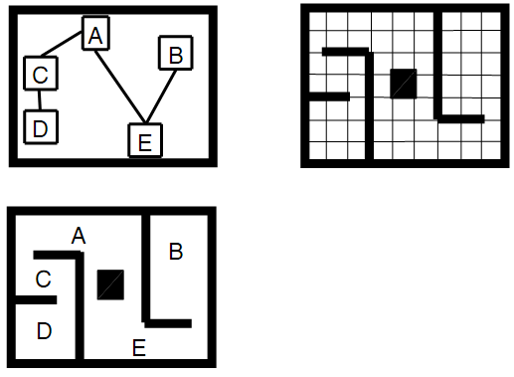
Example 4.9. Representation of the Spatial Environment for Mobile Robots
For a mobile robot, a common representational format must clearly include a full description of the spatial environment.
topological
representations
occupancy grid
representations.
simple two-dimensional
spatial environment
Fig. 4.4. the Spatial Environment for Mobile Robots
Topological Representation.
a graph-like structure: nodes⎯ specific land marks or places; arcs ⎯ paths;
The position of the robot is determined relative to distinct spatial landmarks. ⎯ no need to accurately determine the absolute location of the robot in the common coordinate system.
Notes:
The following example illustrates how we take these factors into account when choosing an appropriate common representational format.
For mobile robots, a common representational format for a mobile robot must clearly include a full description of the spatial environment.
Two common representational formats (Fig. 4.4) which have been used are:

Slide 21
Occupancy Grid Representation.
discretizes the spatial environment into a structure of square cells C_{k} each of size δ ×δ.
Associated with each cell C_{k} is an a posteriori probability.
require an accurate determination of the location of the robot in the global coordinate frame.
sensitive to errors in the location of the robot.
The computational requirements of the occupancy grid are high, however, it provides us with a complete representation of the spatial environment and of its uncertainty. It is also highly adaptable.
The occupancy grid has become the dominant common representational paradigm for mobile robot applications.
□
Notes:
For these reasons the occupancy grid has, in recent years, become the dominant common representational paradigm for mobile robot applications.

Slide 22
4.5 Subspace Methods
（子空间方法）
Dimension-reducing, or subspace, technique ⎯ a low-dimensional common representational form.
Example 4.10. Common Representational Format for a Vehicle Sound Signature Application
Vehicles of the same kind and working in similar conditions generate similar noises. → to detect and classify vehicles
Each vehicle is classified by its power spectrum in the frequency range ∼ [5, 6500] Hz. If each spectrum is sampled every ∼ 5Hz, the corresponding common representational format has N ∼ 1200 dimensions.
By using the principal component analysis (PCA) subspace technique, the number of dimensions can be successfully reduced from N ∼ 1200 to L ∼ 30.
□
Notes:
In many multi-sensor data fusion applications our paramount concern is to keep the computational load and/or the storage requirements low.
This may be achieved by using a low-dimensional common representational format.
One way of producing such a format is to apply a dimension-reducing, or subspace, technique to the raw input data.

Slide 23
Table 4.5. Subspace Techniques
Technique | Description
Principal Component Analysis (PCA) | Linear transformation chosen so the projected components have maximum variance.
Linear Discriminant Analysis (LDA) | Linear transformation for K ≥ 2 classes. Transformation is chosen so the projected components for each class are maximally separated from the projected components of the other classes.
Independent Component Analysis (ICA) | Linear transformation chosen so the projected components have maximized independence.
Non-Negative Matrix Factorization (NMF) | Finds factors with non-negative elements.
Canonical Correlation Analysis (CCA) | For K classes defines K linear transformations. For K = 2 the transformations are chosen so the projected components of each class are maximally correlated.
Notes:
Table 4.5 lists some of the principal subspace techniques which are commonly used for dimension-reducing purposes.
Two popular subspace technique are principal component analysis (PCA) and linear discriminant analysis (LDA).

Slide 24


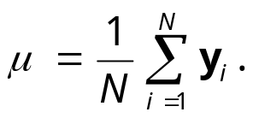
4.5.1 Principal Component Analysis （主成分分析）
An unsupervised technique which builds a low-dimensional common representational format using a set of input vectors y_{i}, i ∈ {1, 2, . . .,N}.
Example 4.11. Principal Component Analysis
PCA is to find a L-dimensional linear projection that best represents the input data in a least squares sense.
Let the input data be a set of M-dimensional input vectors y_{i}, i ∈ {1, 2, . . ., N}, where y_{i} = (y_{i}⁽¹⁾ , y_{i}⁽²⁾ , . . . , y_{i}^{(M)} )^{T} .
Define a reduced L-dimensional space using a set of orthonormal axes u_{l}, l ∈ {1, 2, . . ., L}, then
is a L-dimensional representation of y_{i} , where

Slide 25

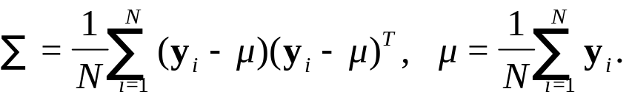
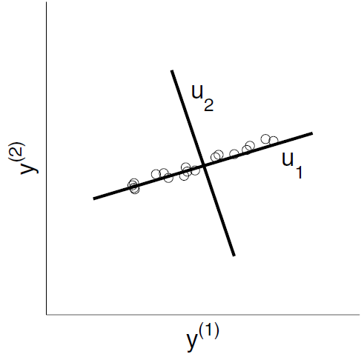
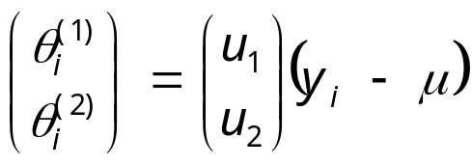
The orthonormal axes u_{l}, l ∈{1, 2, …, L}, are given by the L dominant eigenvectors of the sample covariance matrix Σ,
where
The PCA representation consists of vectors u₁ and u₂,
The dominant vector is u₁.
Fig. 4.5. Two-dimensional input measurements y_{i}, i ∈ {1, 2, . . . ,N}.
□

Slide 26
Table 4.6. Principal Component Analysis and its Variants
Technique | Description
Principal Component Analysis (PCA) | The basic PCA algorithm. PCA maximizes the variance of all linear projections.
Probabilistic PCA (PPCA) | Places PCA in a probabilistic framework.
Weighted PCA | Each input measurement y_{i} is given a different weight before PCA is performed.
Incremental PCA | Given an existing PCA and a new measurement y, incremental PCA calculates the new PCA without recalculating the covariance matrices.
Robust PCA | Performs PCA using robust techniques.
Kernel PCA | Generalizes the PCA to non-linear transformations.
2D-PCA | Performs PCA on two-dimensional input matrices. Useful in image processing and computer visual applications.
Notes:
In many multi-sensor data fusion applications it is convenient to use a probabilistic common representational format in which we transform the measurements yi into L-dimensional a posteriori probabilities p(θi|yi, I).
To carry out this transformation we use a probabilistic PCA (see Sect. 9.6.3).
In Table 4.6 we list some of the PCA variants which are in common use.

Slide 27

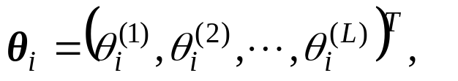

4.5.2 Linear Discriminant Analysis （线性判别分析）
A supervised technique in which each input measurement y_{i} is associated with a given class C = c_{k}, k ∈ {1, 2, . . .,K}.
LDA is to find a L-dimensional subspace in which the different classes are maximally separated. The L-dimensional LDA representation of y_{i} ,
then,
u_{l} is a solution of the eigenvector equation:
where,
Σ_{B} and Σ_{W} ⎯ two covariance matrices which measure, respectively, the scatter of the y_{i} “between-classes” and “within-classes”.

Slide 28
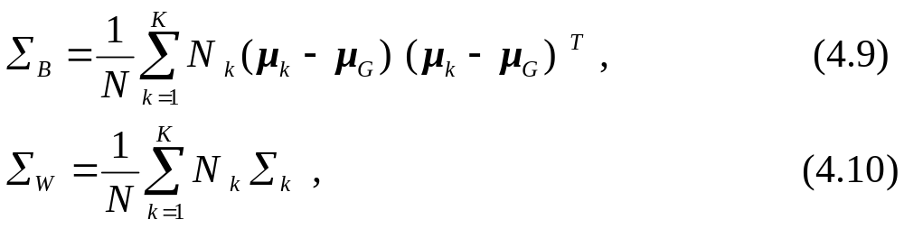
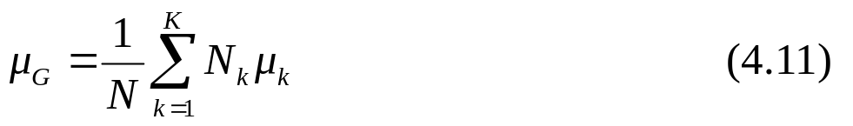
Covariance matrices
N_{k} ⎯ the number of input measurements which belong to class c_{k},
μ_{k} and Σ_{k} ⎯ the mean vector and covariance matrix for the kth class,
The global mean vector ⎯
the rank of Σ_{B} is bounded from above to K − 1 → L ≤ (K − 1).
Notes:
In many multi-sensor data fusion applications this restriction on L is too severe.

Slide 29
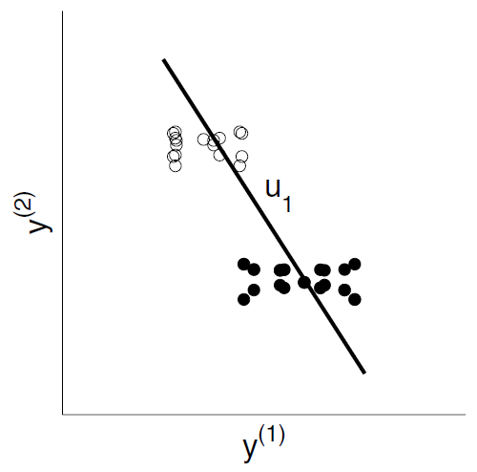
For a two-class problem (K = 2), this restriction L ≤ (K − 1) is too severe.
⎯ class c₁;
• ⎯ class c₂;
Only a single vector labelled u₁ which joins μ₁ and μ₂.
Fig. 4.6. Two-dimensional input measurements y_{i}, i ∈ {1, 2, . . . ,N}.
To obtain a richer common representational format, Σ_{B} can be replaced with a modified matrix whose rank is greater than K−1.

Slide 30

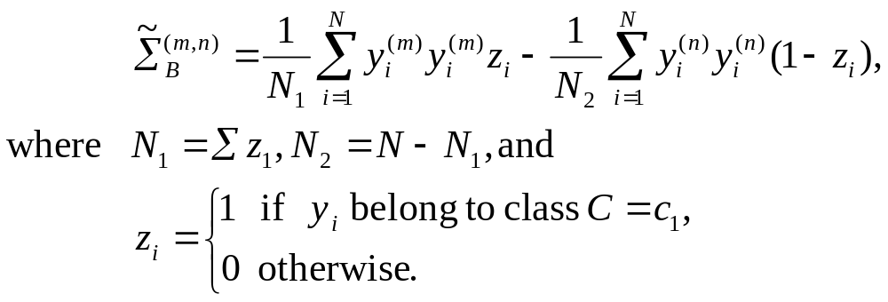
Example 4.12. The Chen-Yang LDA Algorithm
Using a modified between-class scatter matrix, .
For two classes C = c₁ and C = c₂, the (m, n)th component of is defined as
The rank of is greater than one and this increases the number of non-zero eigenvalues beyond the upper limit set by LDA.
□

Slide 31



Example 4.13. Chemical Sensor Analysis: Principal Discriminant Analysis (PDA) for Small-Sample Size Problems
The decomposition of in (4.8) is only possible if the matrix is non-singular. → the number of training samples, N, should be larger than L, i.e. to be larger than K − 1. Even if N >L, the LDA has a tendency to “overfit” when N ~ 10L.
performing the eigenvalue decomposition on a modified matrix .
where
is the global covariance matrix ,
and ε ∈ [0, 1] is a regularization parameter.
For ε> 0, the LDA solution is regularized by incorporating information on Σ_{G}.
As in Ex. 4.12, the PDA increases the number of non-zero eigenvalues beyond the upper limit set by LDA.
□
Notes:
The polar image contains 32 sectors. The sectors are formed by dividing the left ventricle into four slices (Basal, Mid-Basal, Mid-Apical and Apical) and dividing each slice into 8 sectors.

Slide 32
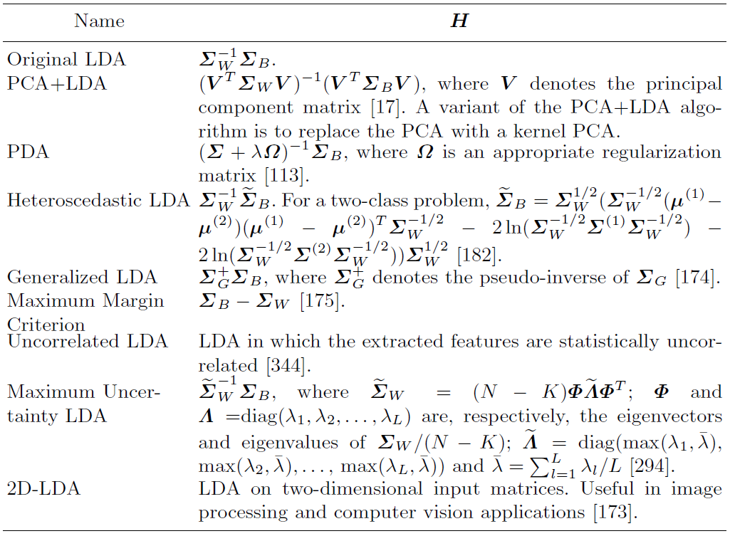
Table 4.7. LDA and its Variants

Slide 33
4.6 Multiple Training Sets
（多训练集）
Ensemble learning （集成学习）
employ an ensemble of multiple functions, or classifiers, S_{m}, m ∈{1, 2, ..., M}, where each function S_{m} is learnt on its own training set D_{m}.
Given a common training set D, an ensemble of training sets, D_{m}, m ∈{1, 2, ..., M} is generated by simply sub-sampling (with, or without, replacement) D. D_{m} share the same common representational format.
Example 4.14. Bagging: Multiple Training Sets Sharing a Common Representational Format.
D ⎯ a training set of N measurements y_{i}, i ∈{1, 2,...,N}.
Multiple training sets D_{m}, m ∈{1, 2,...,M} ⎯ formed by bootstrapping D, i.e. randomly sampling D with replacement and a uniform probability of selection.
Notes:
R. O. Duda, etc. Pattern classification. 2nd Edition. John Wiley & Sons, Inc.
9.5 分类器设计中的重采样技术：
9.5.1bagging 算法
一个通用的缩略语“arcing”(adaptive reweighting and combining,自适应的权重充值和组合）是指这样的过程：重新使用或选择数据，以期达到改善分类器性能的目的。
最简单的版本就是bagging算法，名字来自于bootstrap aggregation（自助聚集），过程如下：
从大小为n的原始数据集D中，分别独立随机地抽取m个数据（m<n）形成自助数据集，并且将这个过程独立进行许多次，直到产生很多个独立的自助数据集。

Slide 34
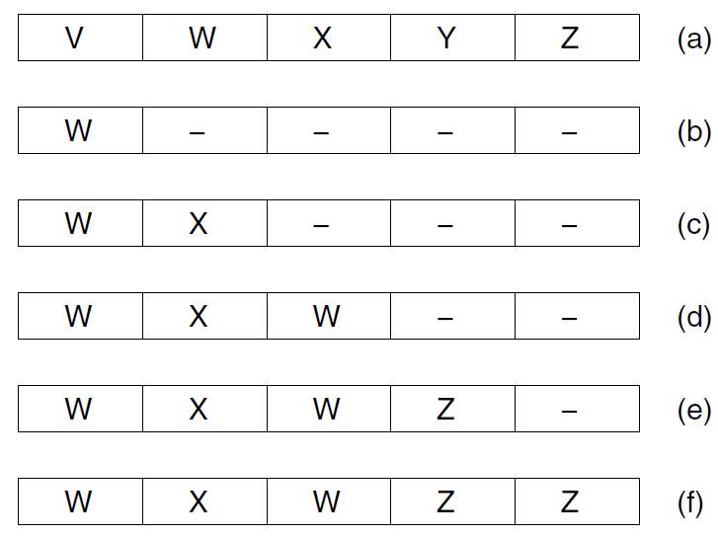
Fig. 4.7. Creation of a training set D_{m} by bootstrapping a common
training set D = {V,W,X,Y,Z}.
(a) the common training set D. (b) the ﬁrst element of D_{m}. This was chosen by randomly selecting one of the samples in D with a uniform probability of selection. (c), (d) and (e) Show, respectively, the ﬁrst two, three and four samples in Dm. (f) Shows the complete bootstrapped training set D_{m}.
Note. The bootstrapped training set D_{m} contains, as expected, ≈ 63.2% of the samples {V,W,X,Y,Z} in D.

Slide 35
Table 4.8. Methods for Sampling a Common Training Set D
Method | Description
Cross-Validation | Partition the common training set D into M disjoint slices (similar to that used in cross-validation). Each classifier S_{m} is trained on a training set D_{m}, where D_{m} is the common training set D less the examples in the m slice.
Bagging (Bootstrap) | Perturb D by randomly sampling D with replacement. The sampling is made with an uniform probability random selection procedure. The entire procedure is repeated M times to create M different, although overlapping, training sets D_{m}. Each D_{m} contains N samples. On average each perturbed training set will have 63.2% of the samples in D, the rest being duplicates.
Wagging | use a non-uniform probability. The non-uniform probabilities are calculated by stochastically assigning a different weight to each sample in D and then normalizing the weights to one. Each training set D_{k} is generated using a different set of non-uniform probabilities.

Slide 36

Table 4.8. Methods for Sampling a Common Training Set D
(continued)
Method | Description
Boosting | use the classification results obtained with the mth classifier, S_{m}, to learn D_{m} +1. The classifier S_{m} is itself learnt on D_{m}. D_{m} +1 is created by re-sampling D such that samples which are misclassified by S_{m} have a higher chance of being chosen than samples which were correctly classified by S_{m}.
Multi-Boosting | Create a set of M data sets D_{m}, m ∈{1, 2,...,M} by boosting a common training set D. Each boosted training set D_{m} is then bagged, or wagged, to generate M’ new training sets

Slide 37
Multiple common representational formats
Each training set D_{m} to have its own common representational format.
Given a common training set D, we may generate an ensemble of training sets D_{m}, m ∈{1, 2,...,M}, where each D_{m} has a different common representational format, by applying a subspace technique to D and then sub-sampling (with, or without, replacement) the result.
Example 4.15. Input Decimated Samples.
Input decimated samples on a common training set D which contains N two-dimensional samples y_{i}, i ∈{1, 2, ..., N}.

Slide 38
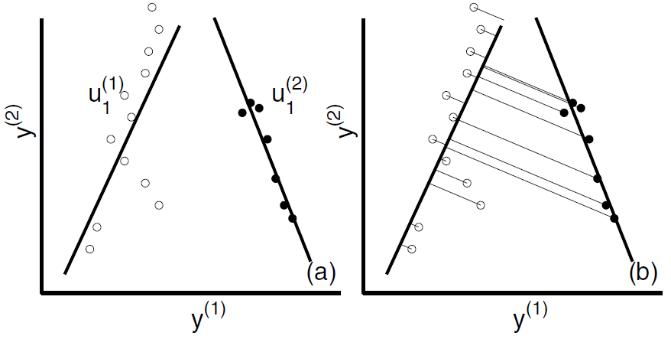

Fig. 4.8. (a) Shows a set of two-dimensional measurements
which belong to a common training set D.
Measurements i ∈{1, 2,...,n}, belong to class C = c₁ and measurements i ∈{n +1,n +2, ..., N}, belong to class C = c₂.
Overlaying the {y_{i}} are the dominant principal axis u^{(k)}₁ for each class C = c_{k}.
(b) Shows the creation of a training set D₁ by projecting the samples y_{i}, i ∈{1, 2, ..., N}, onto the leading axis u⁽¹⁾₁ .

Slide 39
Table 4.9. Methods for Generating Multiple Common Representational Formats
Name | Description
Random Subspace Method (RSM) | Form training sets D_{m}, m ∈{1, 2 ,..., M}, by randomly selecting which dimensions to retain.
Random Projections | Form a random L×L’ matrix R, where L’ is the number of dimensions which are to be retained. Each element in R is random number chosen from N(0, 1) distribution and normalizing the columns to one. We apply to each sample y_{i}, i ∈{1, 2, ..., N}, and thus obtain a new (L’-dimensional) sample y_{i}’=R^{T} .
Input Decimated Samples | Divide samples in D according to their class variable. For each class, C = c_{k}, find the corresponding PCA transformation U. Generate D_{k} by applying U, or only the dominant columns in U (i. e. only eigenvectors with large eigenvalues), to all samples in D. Note: The number of training sets is limited to the number of class K.

Slide 40

Table 4.9. Methods for Generating Multiple Common Representational Formats (continued)
Name | Description
Rotation Forest | Similar to the method of Input Decimated Samples. However, in Rotation Forest the number of D_{m} is not limited to the number of classes present.
Skurichina-Duin | Find PCA transformation U on the common training set D. Then form the D_{m} as follows: D₁ is formed by applying the first K columns of U to D, D₂ is formed by applying the next K columns of U to D, etc., where K is a suitably chosen number.
In the table we assume that each training sample y_{i} in D is an L-dimensional vector:

Slide 41

Thank you for your attention!

